Slide 1
Ezzat Pashai
A celebration of life and honors

Slide 2
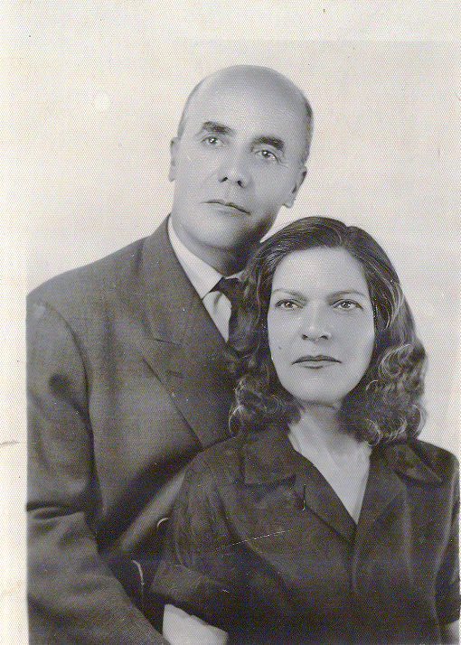
His mother and father

Slide 3
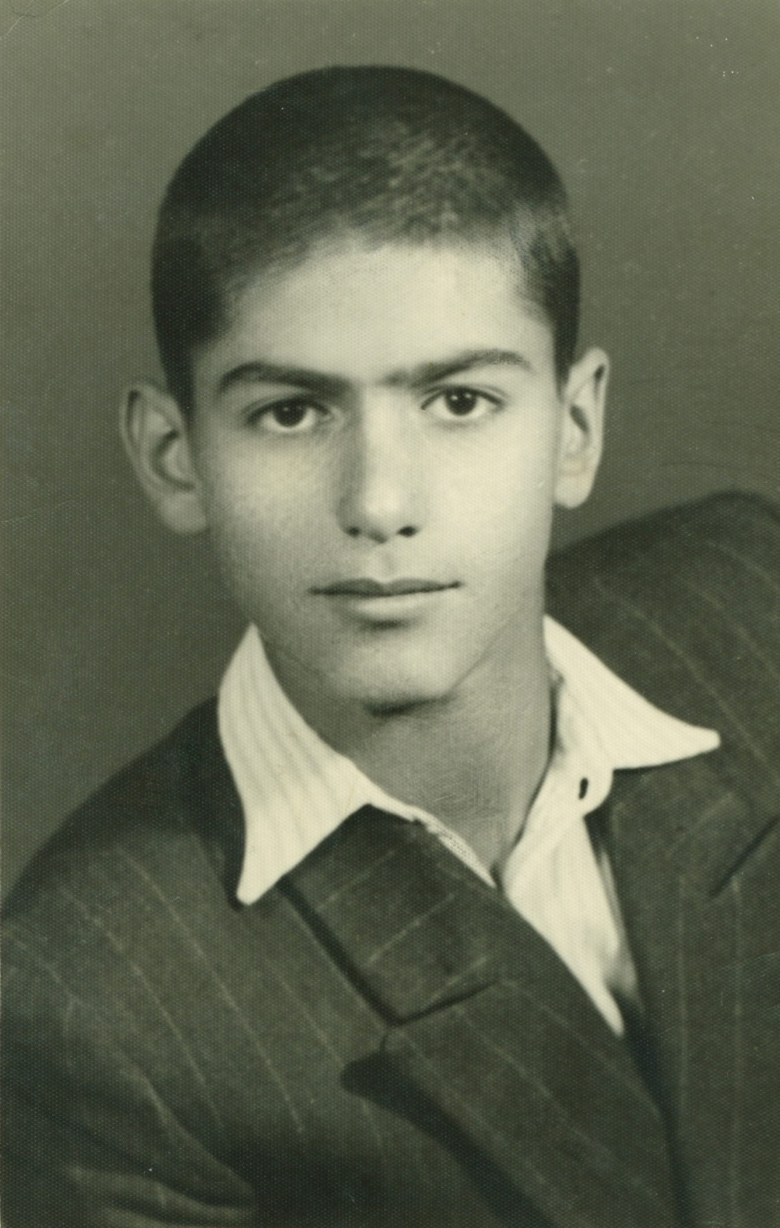

Slide 4
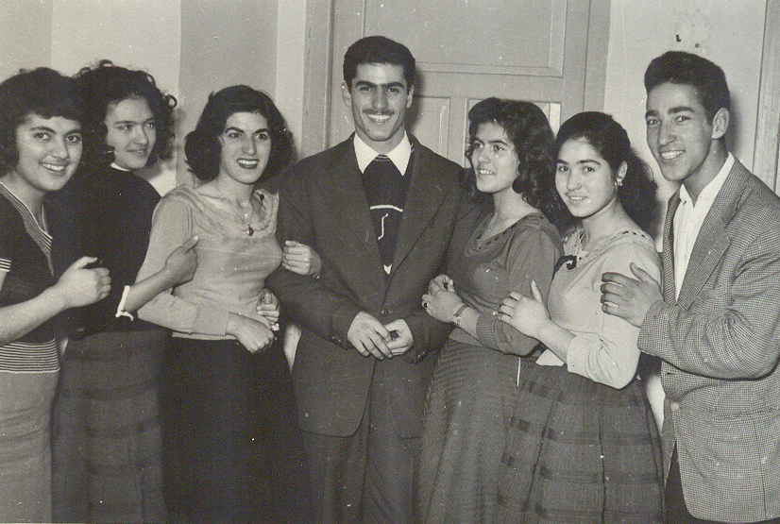
Ezzat in the middle and his two sisters by his side

Slide 5
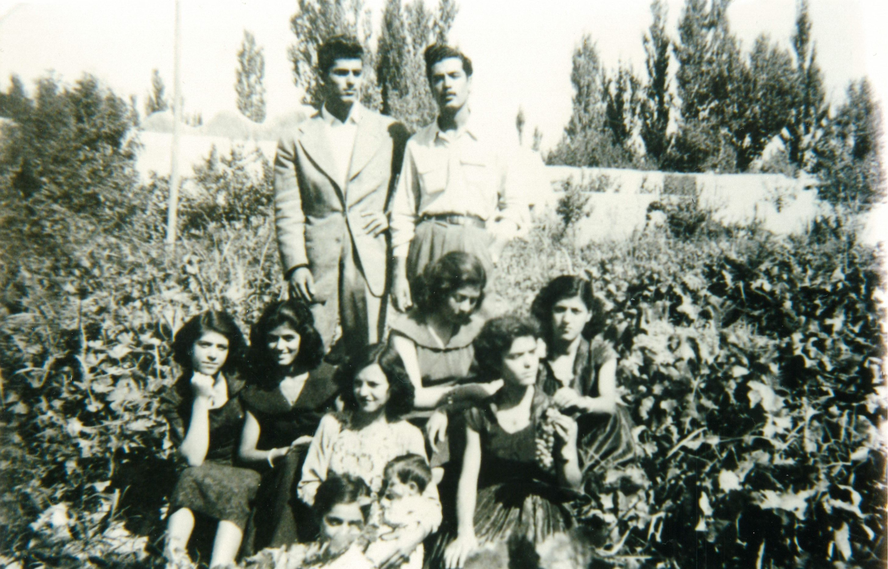
His brother and four sisters.

Slide 6
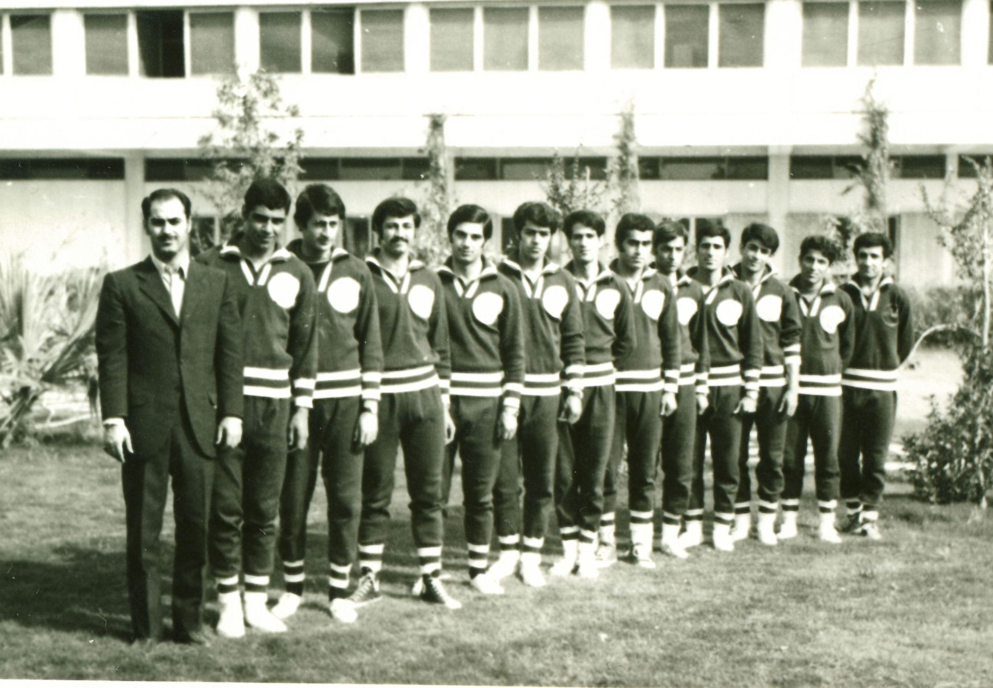
His love was to create athletes.

Slide 7
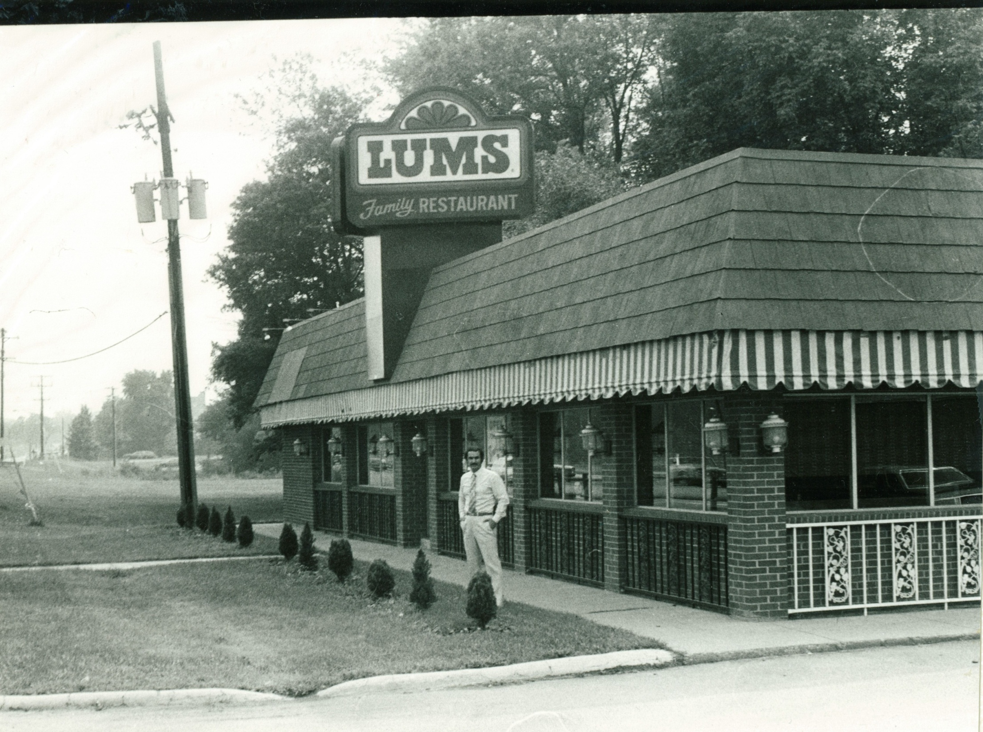
His restaurant in the 70s. He loved to coach, but he refused to get paid as an athlete or a coach.

Slide 8
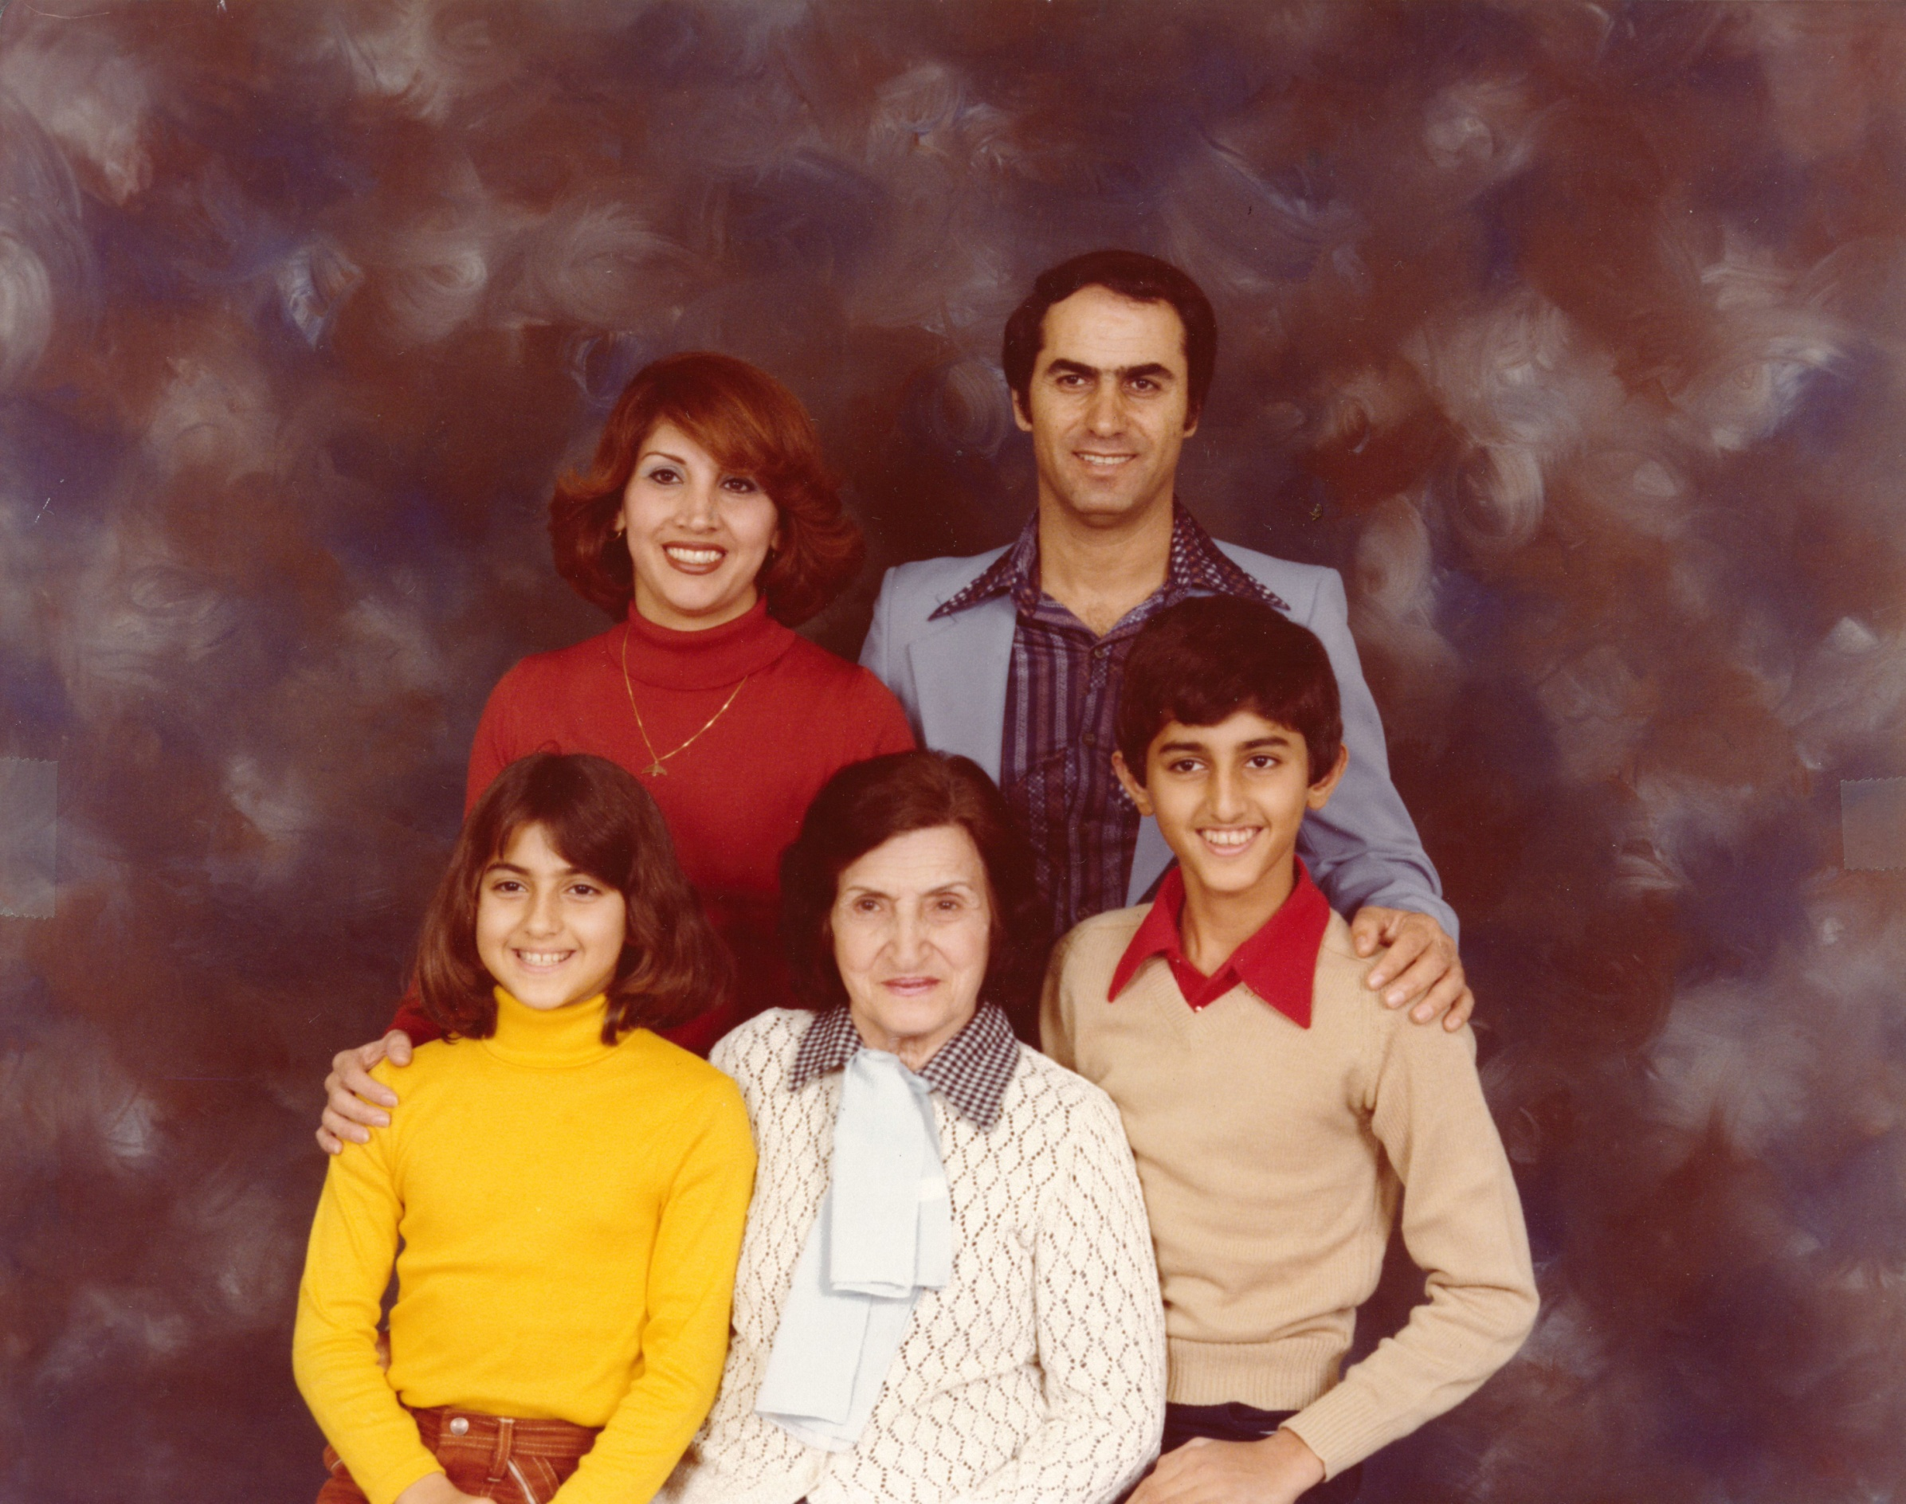
He loved his family and when he moved here, his mother-in-law moved with him as she considered him closer than her 4 sons.

Slide 9
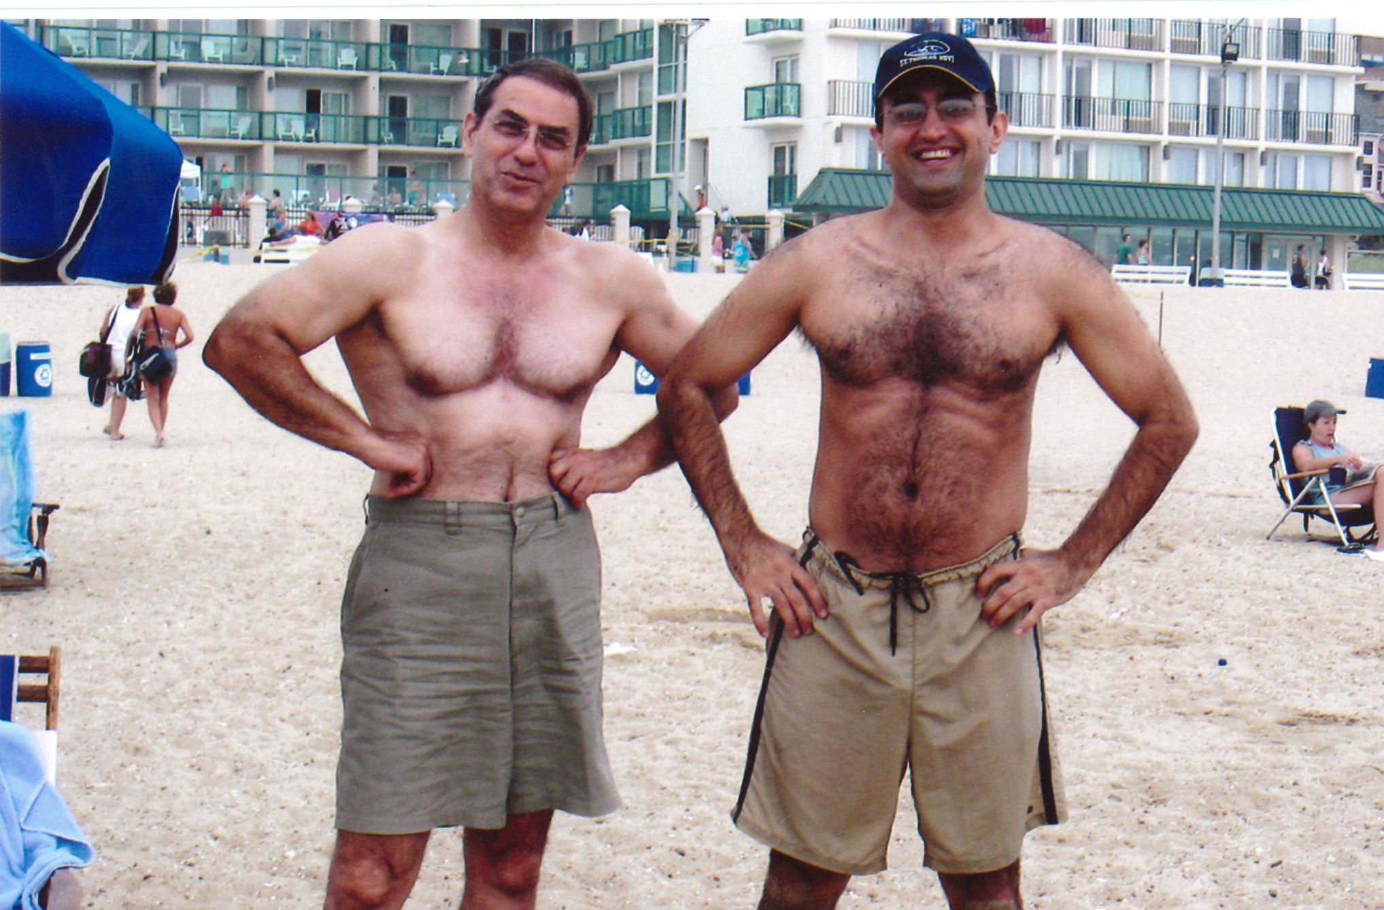
At 70, he would put his own son to shame when it came to physical fitness

Slide 10
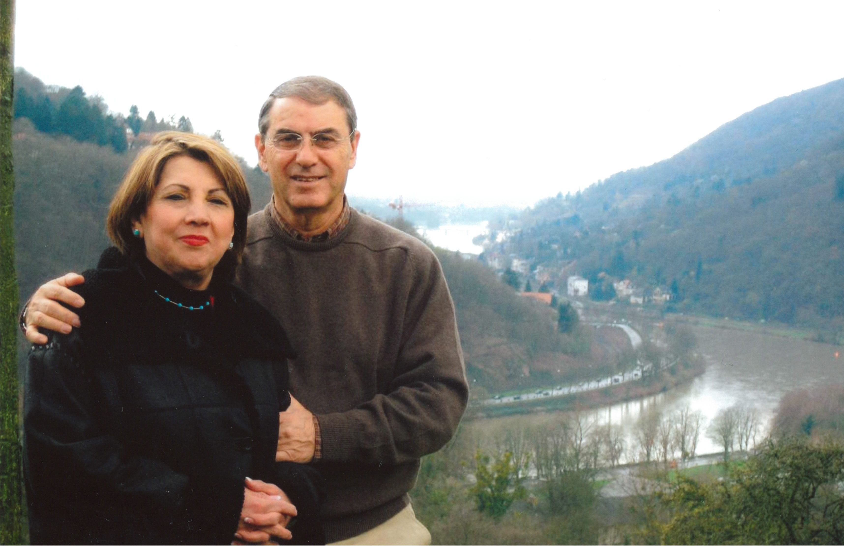
His angel was always at his side

Slide 11
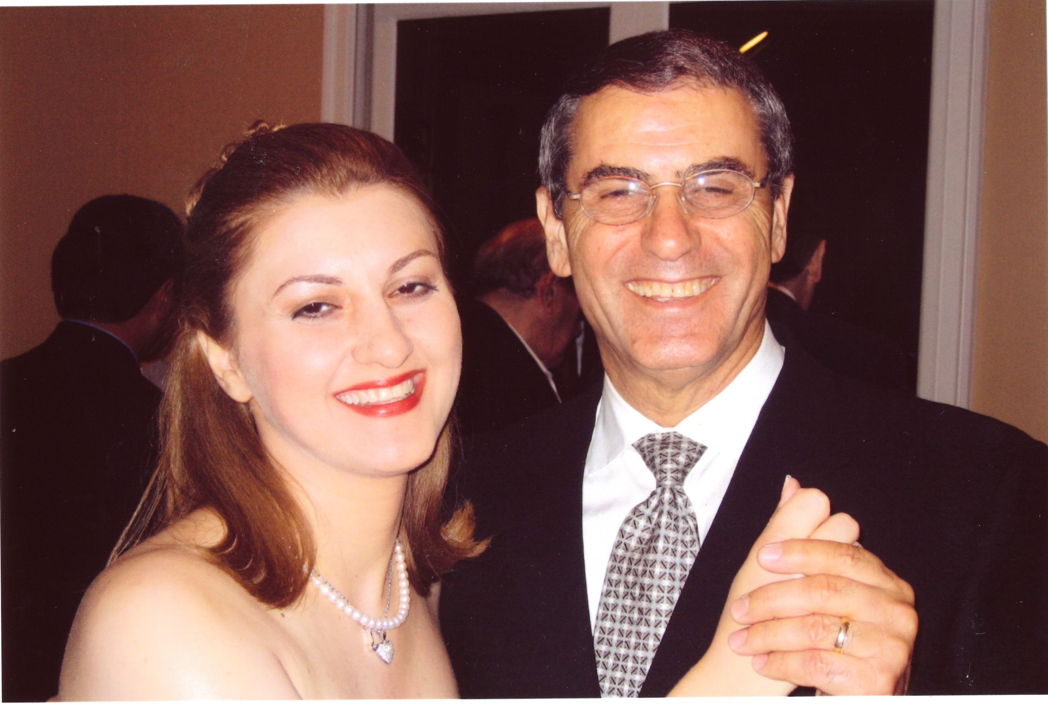
His daughter and second angel.

Slide 12
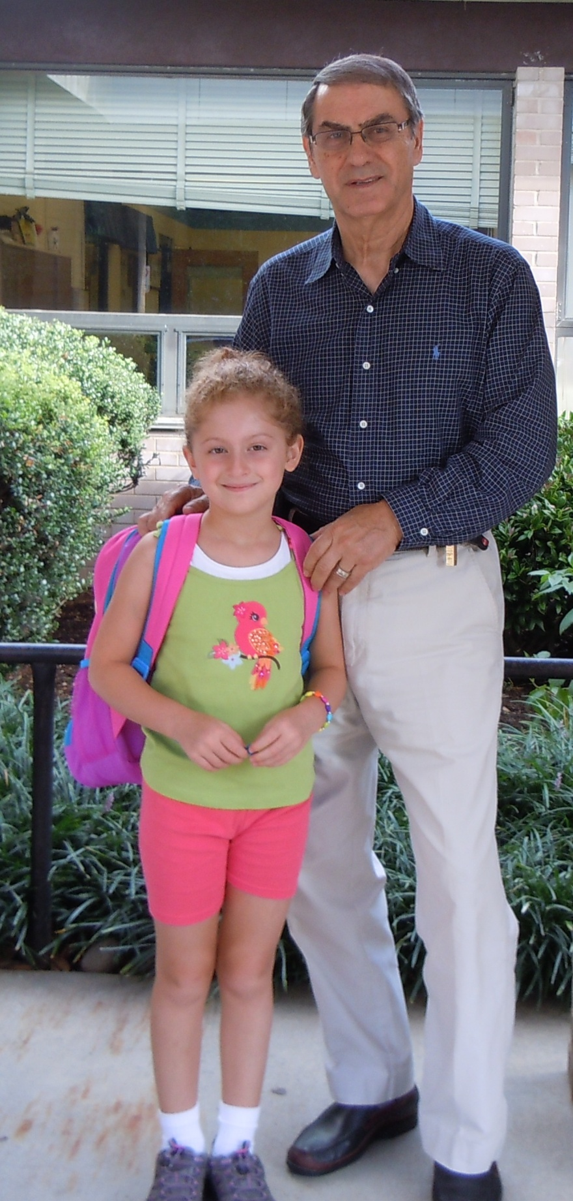
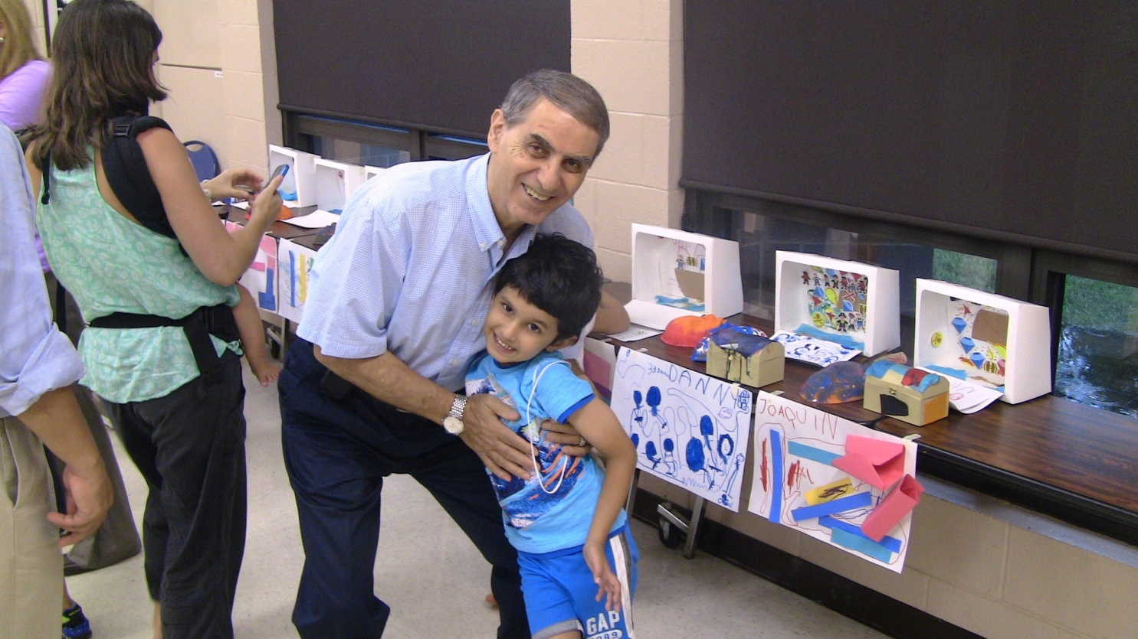
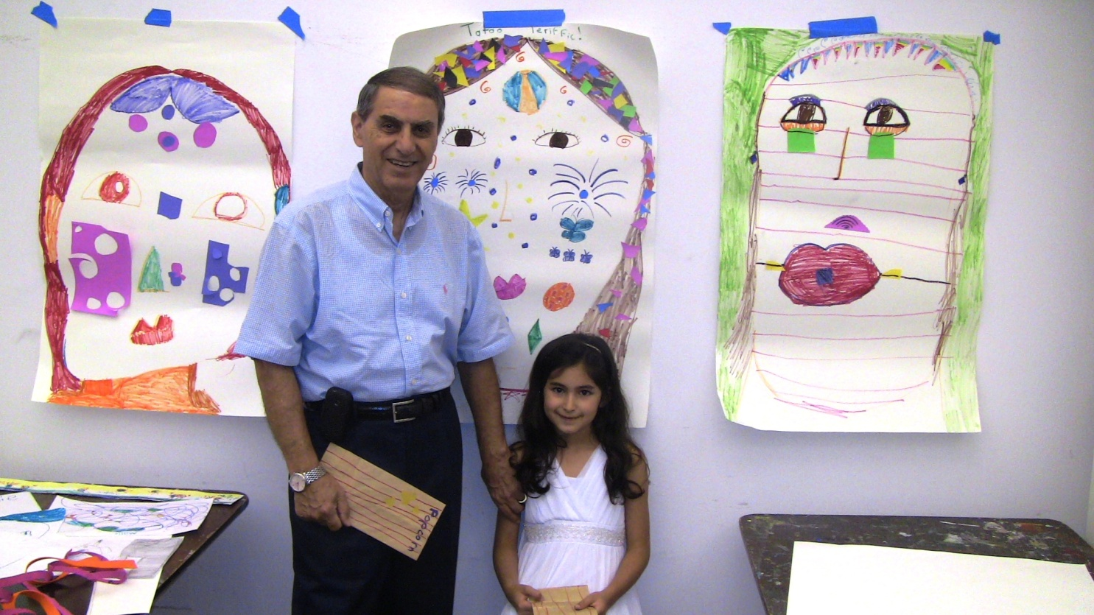
What he was most proud of

Slide 13
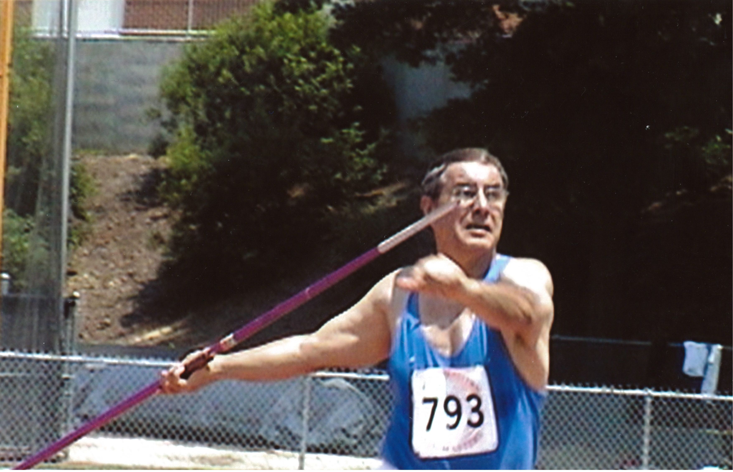

Slide 14
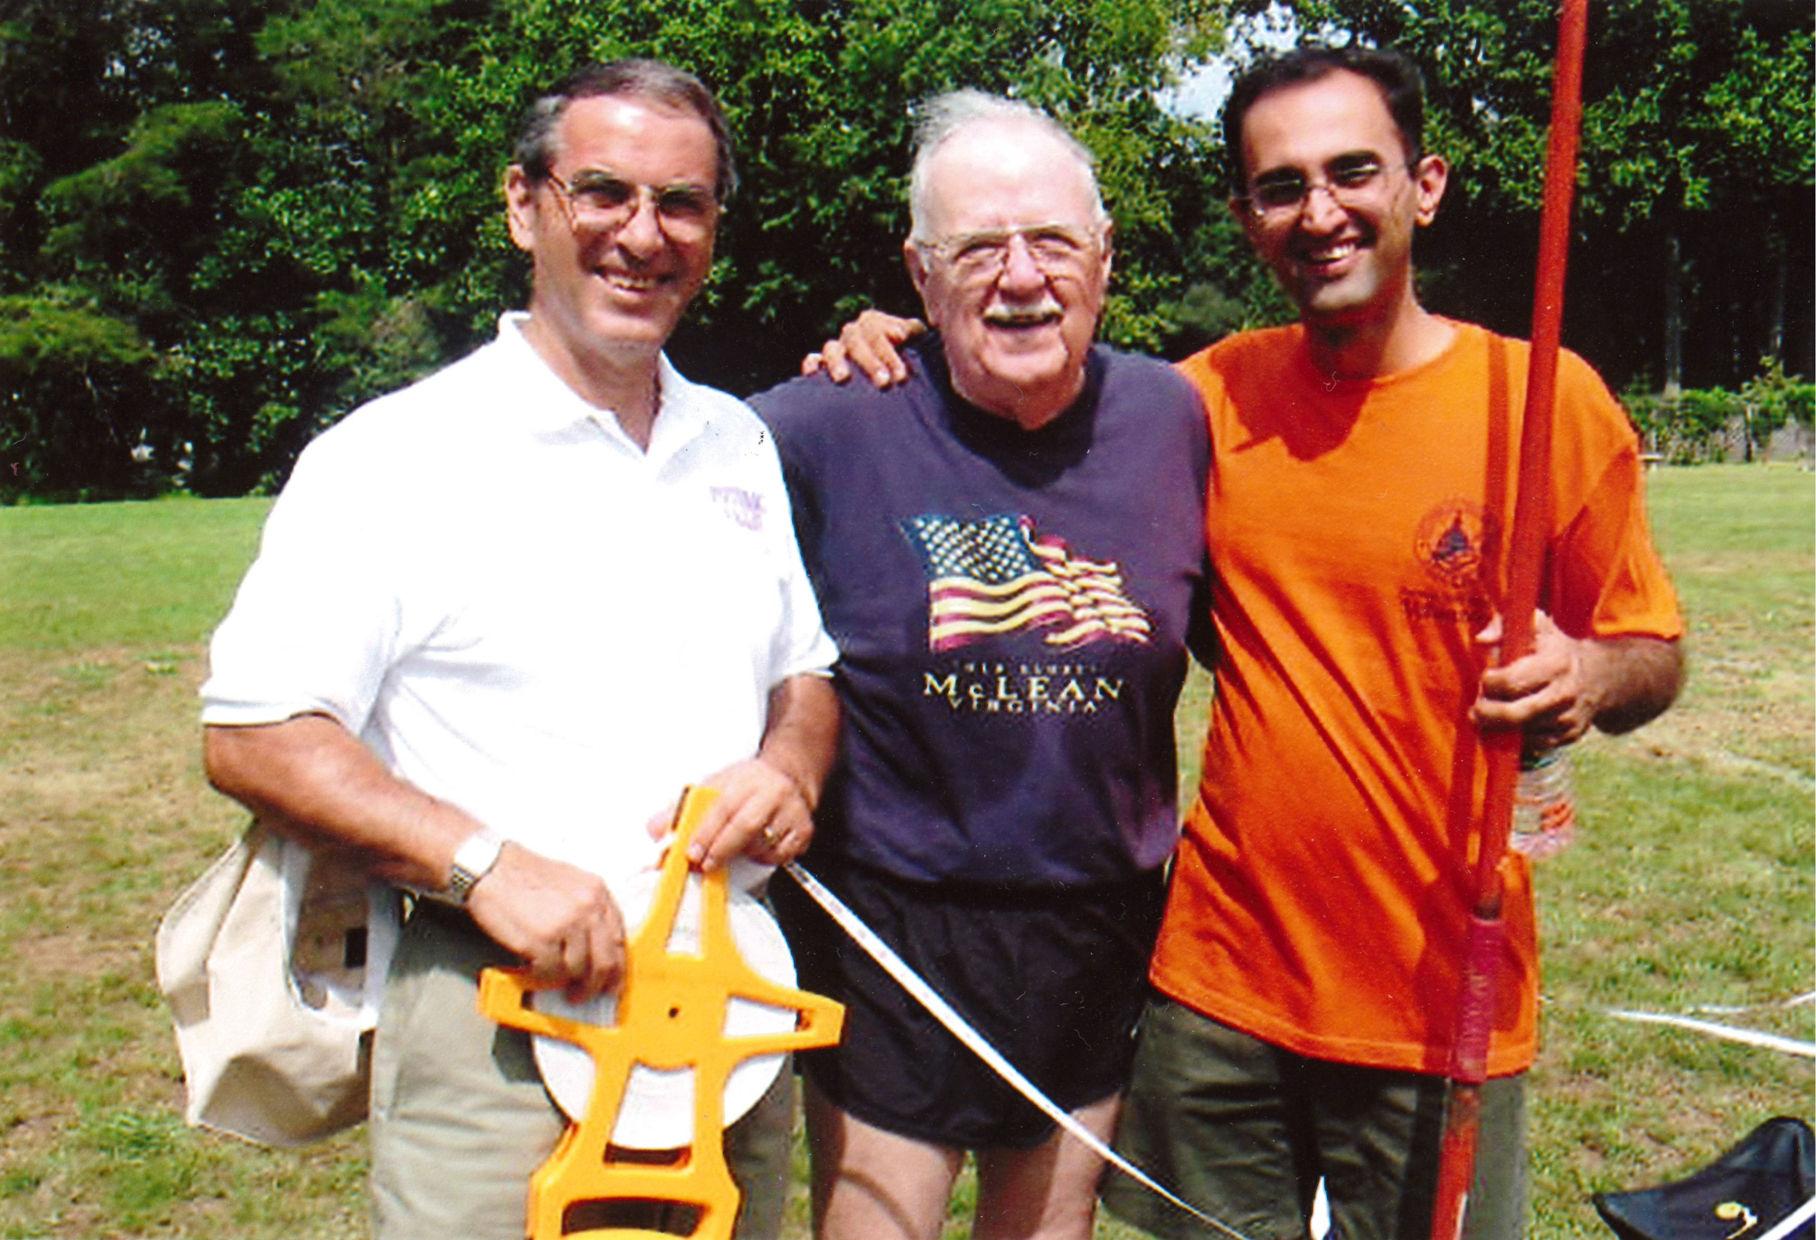
In Iran, he made his living by operating the only two stadiums in the capital and he was happiest when on the field or when teaching in the University. When he came to U.S., no amount of money in his businesses would satisfy him. But when he discovered PVTC, it was like he found his second love.

Slide 15
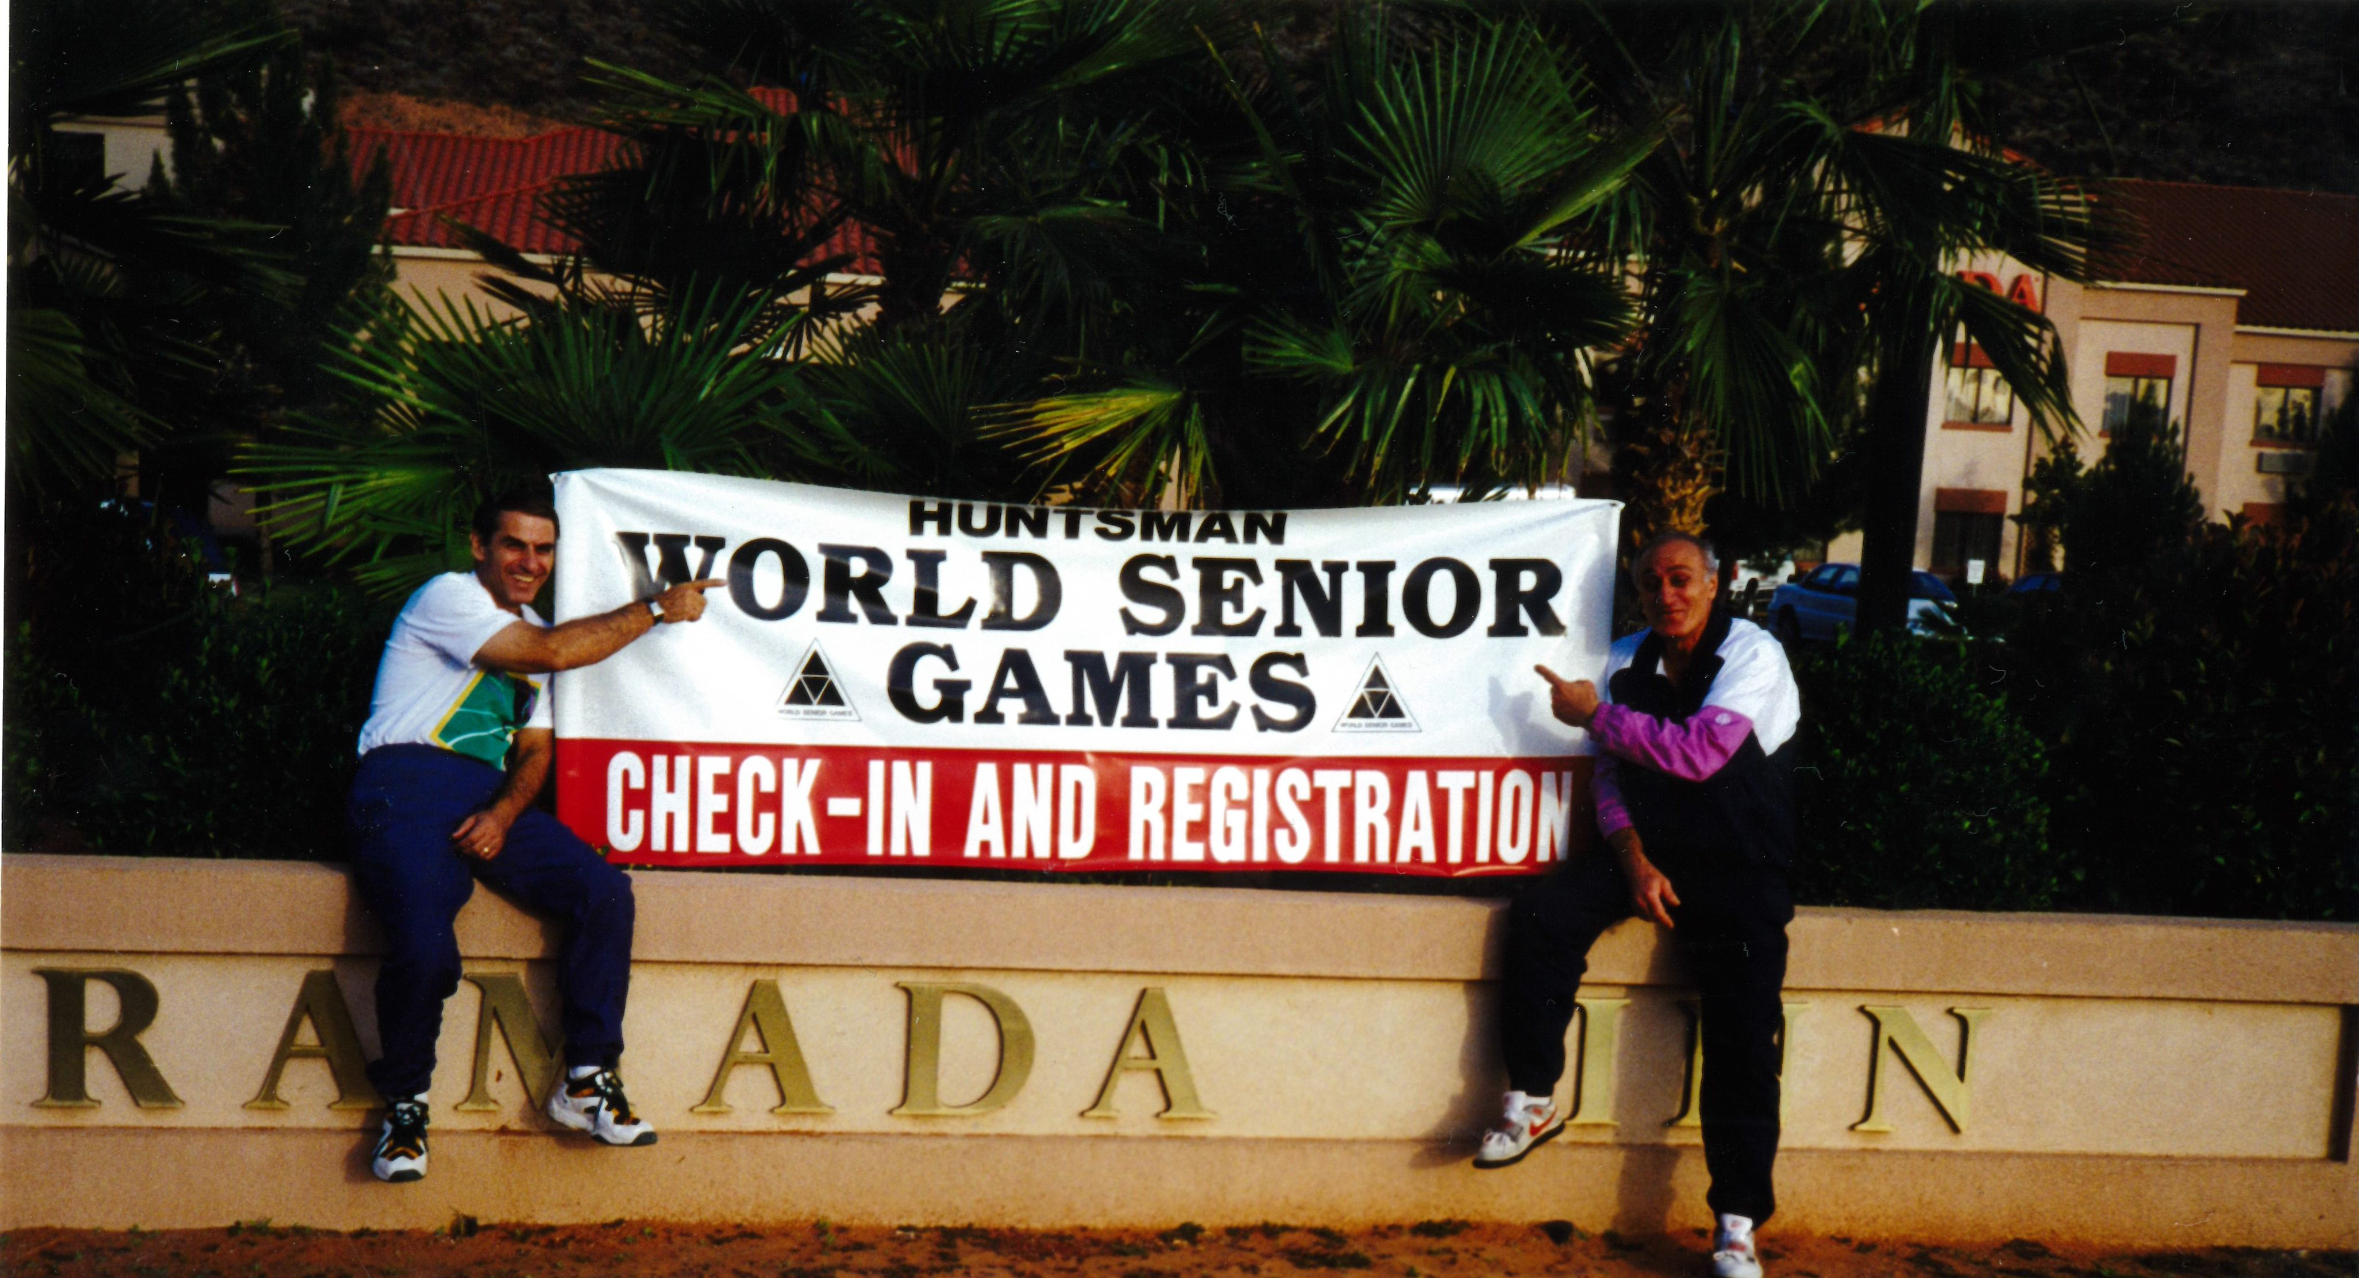
His friendships went back 65 years and he never lost a single friend !
“If someone is going to hold the javelin, its me.”

